Slide 1
Data Extraction

Slide 2
Data Extraction
Data is the most important part of all Data Analytics, Machine Learning, Artificial Intelligence. Without data, we can’t train any model and all modern research and automation will go vain.
Is the process of collecting or retrieving different types of data from a variety of sources, many of which may be poorly organized or completely unstructured.
Data Extraction makes it possible to consolidate, process and refine data so that it can be stored in a centralized location in order to be transformed.

Slide 3
ETL Process
Briefly consider as ETL process as a whole
E -- Extraction T – Transformation L -- Loading

Slide 4
Extraction Data is taken from one or more sources or systems. The extraction locates and identifies relevant data, then prepares it for processing or transformation.
Transformation Once the data has been successfully extracted, it is ready to be refined. During the transformation phase, data is sorted, organized, and cleansed. For example, duplicate entries will be deleted, missing values removed or enriched, and audits will be performed to produce data that is reliable, consistent, and usable.

Slide 5
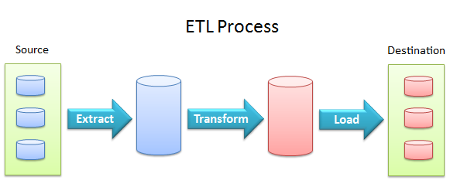
Loading The transformed, high quality data is then delivered to a single, unified target location for storage and analysis.

Slide 6
Types Of Data Extraction
Full Extraction Data is completely extracted from the source, and there is no need to track changes.
Incremental Extraction extracting data that has been changed or added after a well-defined event in the source database

Slide 7
Thank You

